Slide 1

Global Superstore
Sales Dashboard
Interactive Sales Analysis using Microsoft Excel
Powered by
Masoom Raza
Microsoft Excel

Slide 2
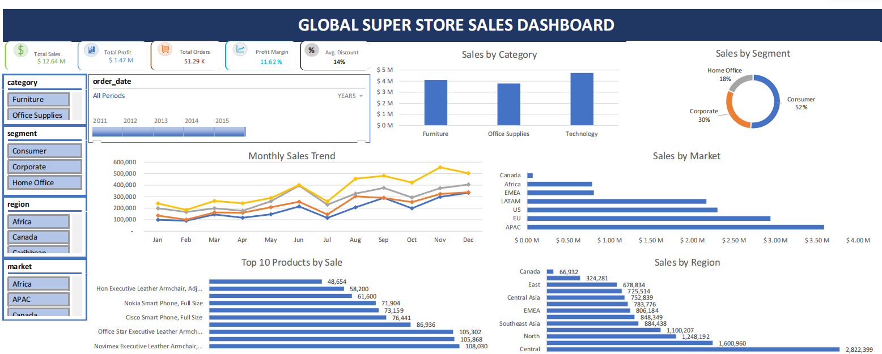
Dashboard Overview

Slide 3
Dashboard Overview
• Total Sales: $12.64M
• Total Profit: $1.47M
• Profit Margin: 11.62%
• Total Orders: 51.29K
• Technology category generated the highest sales.
• Consumer segment contributed the highest revenue.
• APAC was the top-performing market.
• Sales showed an upward trend toward year-end.

Slide 4


Skills Demonstrated
• Data Cleaning
• Pivot Tables
• Pivot Charts
• KPI Cards
• Slicers
• Timeline
• Dashboard Design
• Business Analysis
• Data Visualization
Project Built Using Microsoft Excel

